Slide 1


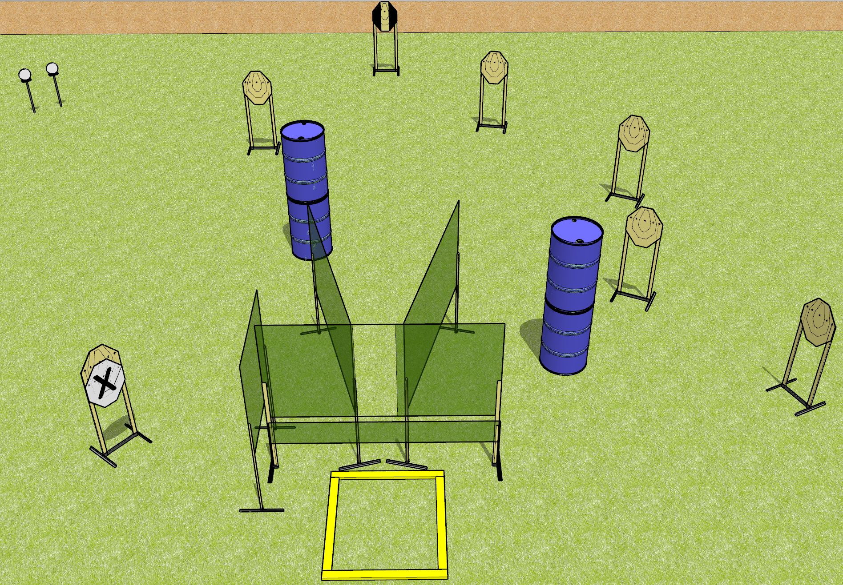
 | Dothan Gun Club – USPSA Match Frag Hurts Course Designer : Drew Coleman
Round Count 16 rounds 8 IPSC 2 plates
Equipment List 8 wall feet 1 outer limits box 1 tuxedo

Slide 2
Frag Hurts
Written Stage Briefing
Frag Hurts is a 16 round, 80 point, Comstock course of fire. There are 8 IPSC targets and 2 falling plates. The best 2 hits on paper will score, and steel must fall to score. The start signal is audible.
Handgun start position is anywhere outside the shooting area, wrists below belt. Handgun is loaded and holstered.
PCC start position is anywhere outside the shooting area, stock on belt. Loaded carbine is held with both hands.
On start signal, engage targets as they become available from within the shooting area.

